Slide 1
Polarity and Segmentation

Slide 2
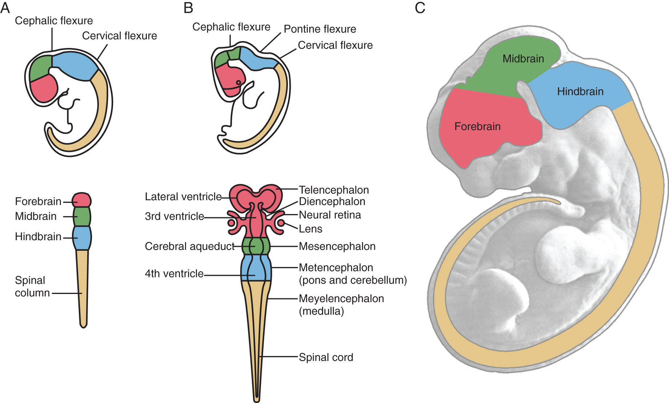
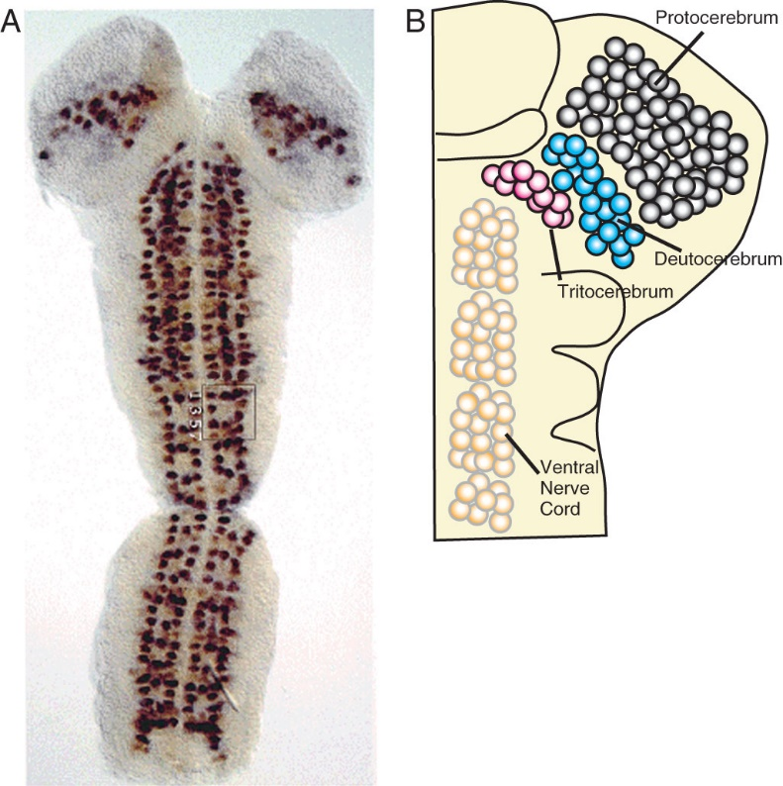
Regional Identity of the Nervous System

Slide 3
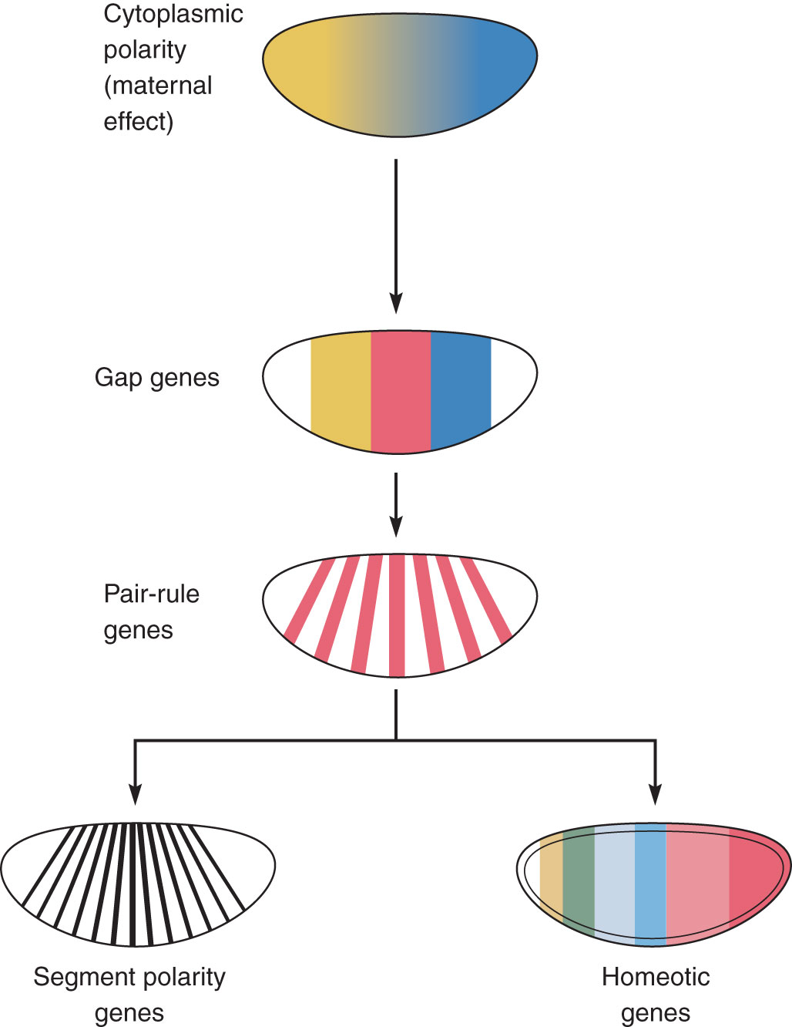
Anterior-Posterior Axis Precedes Neural Induction

Slide 4
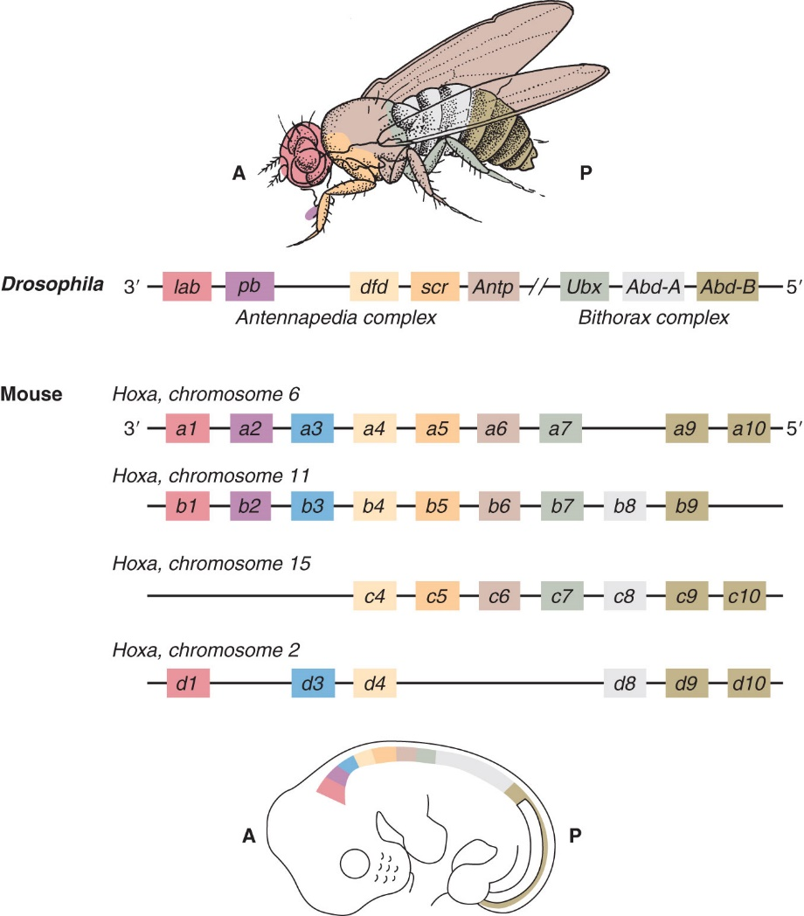
Hox Genes are Conserved Throughout Evolution

Slide 5
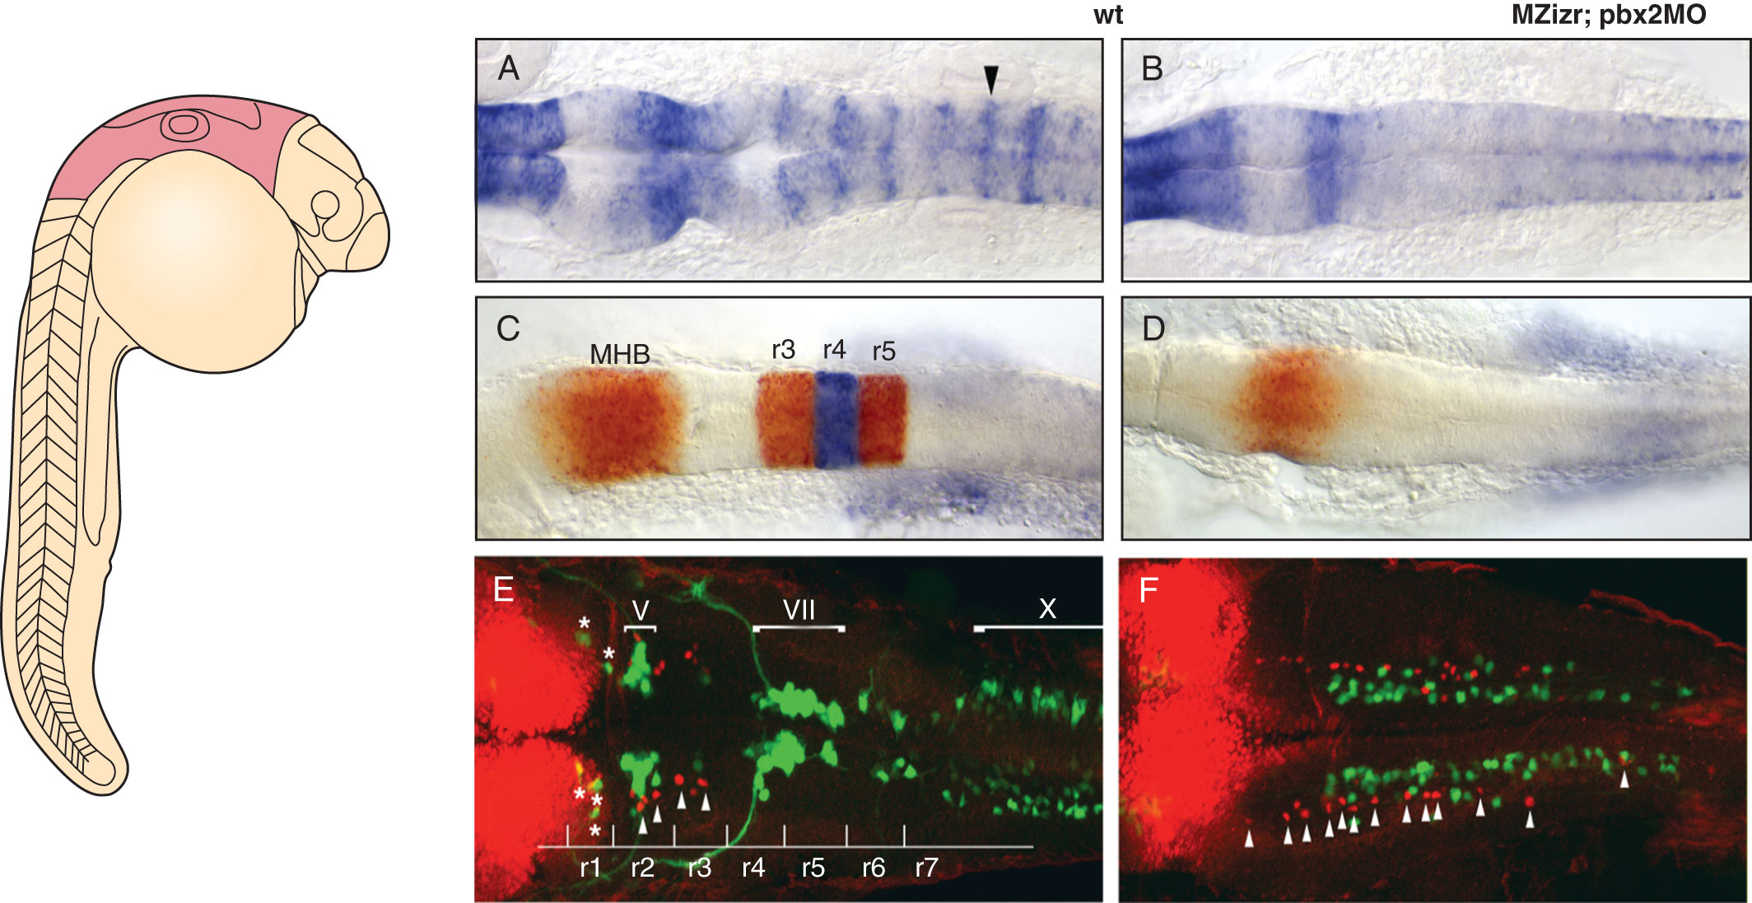
Hox Genes in Vertebrate A-P Patterning

Slide 6
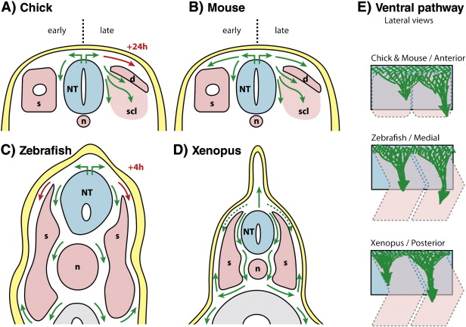
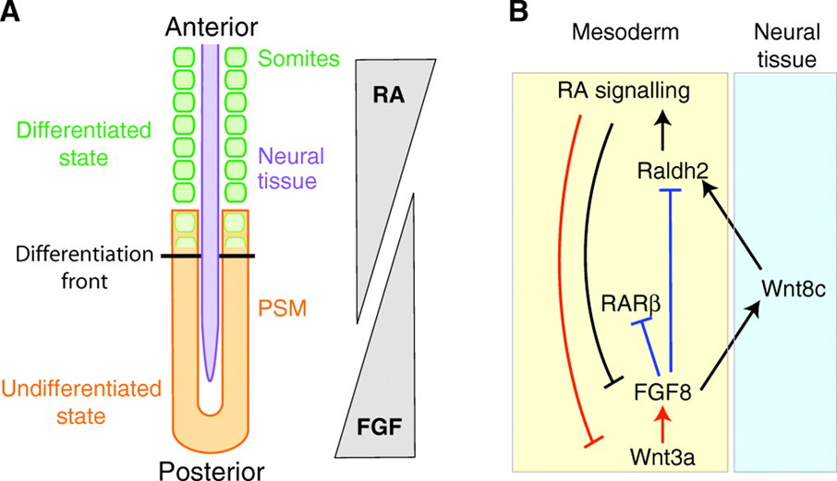
Transformers: Retinoic Acid and Wnts

Slide 7
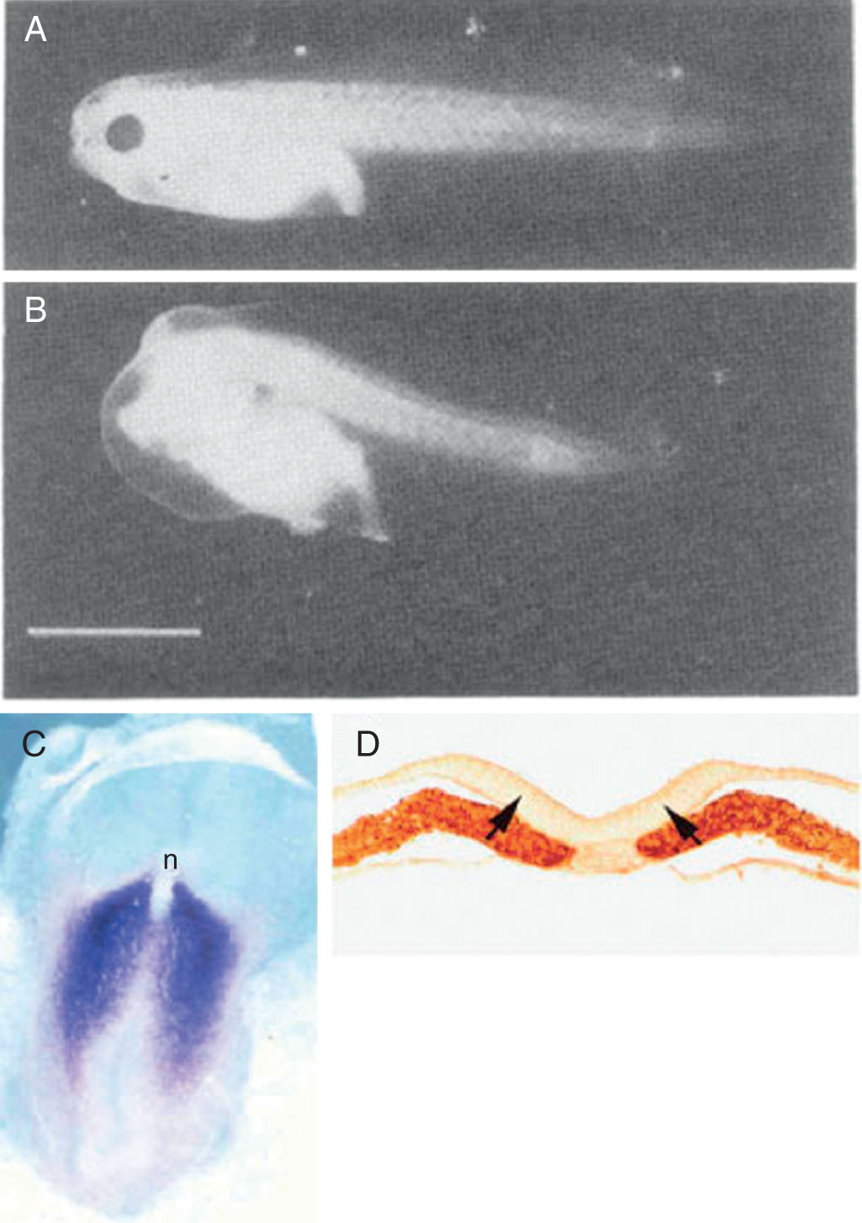
Transformers: Retinoic Acid in A-P Patterning

Slide 8
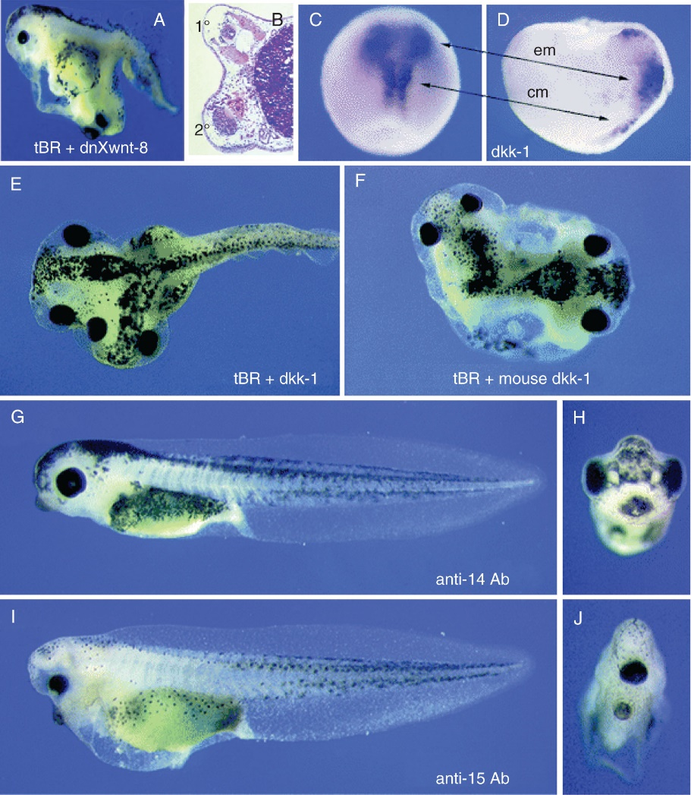
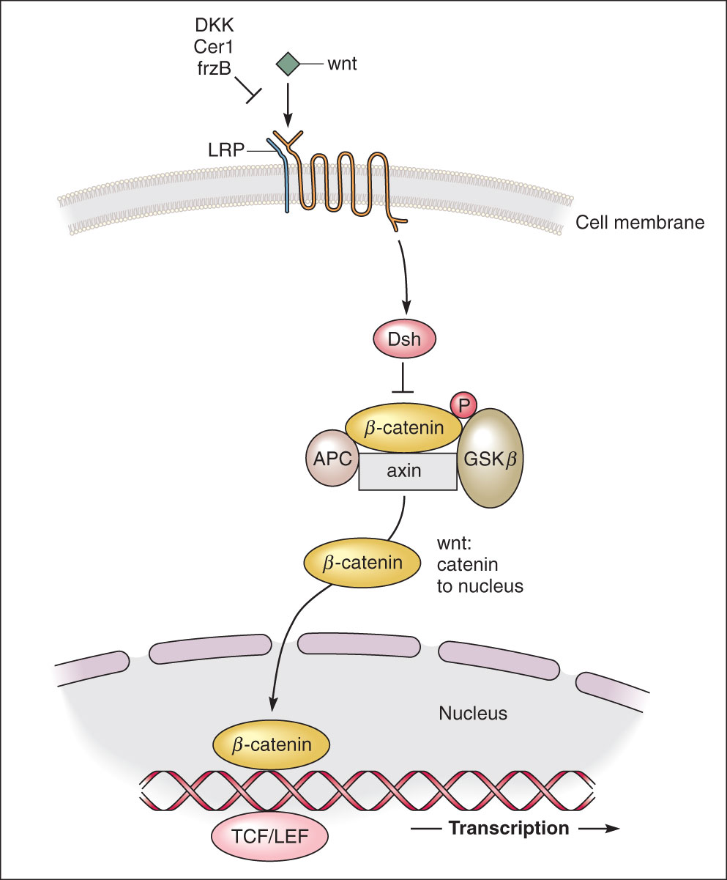
Transformers: Wnt Signaling Inhibits Anterior

Slide 9
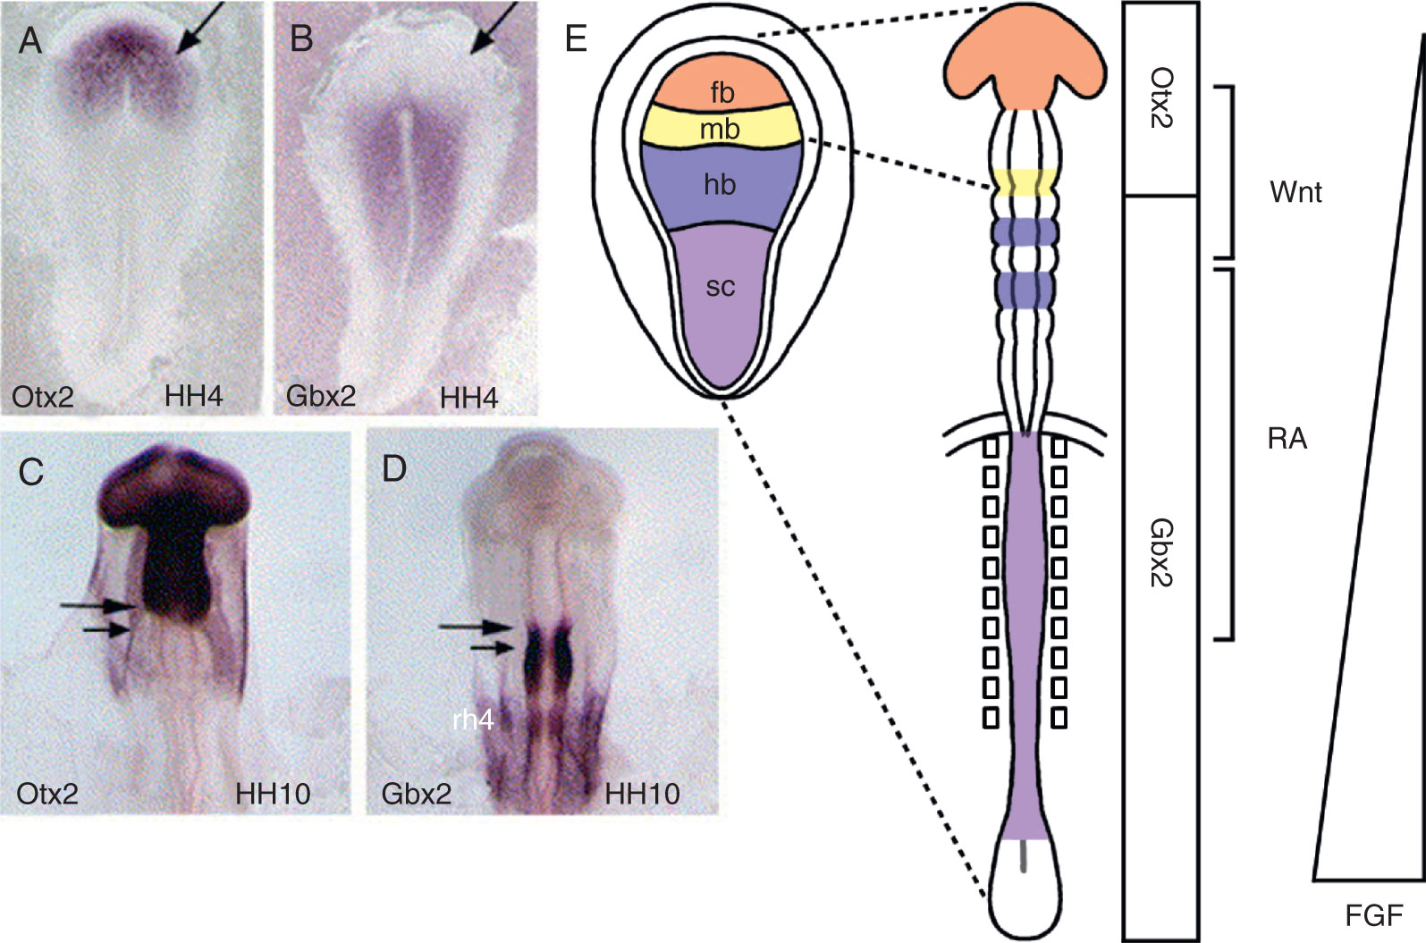
Transformers: FGF with RA and Wnts

Slide 10
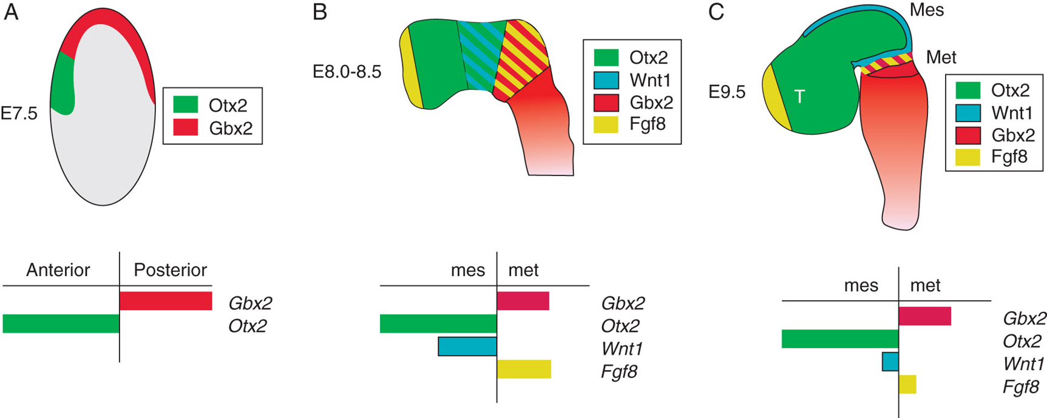
Organizing Centers in the Developing Brain

Slide 11
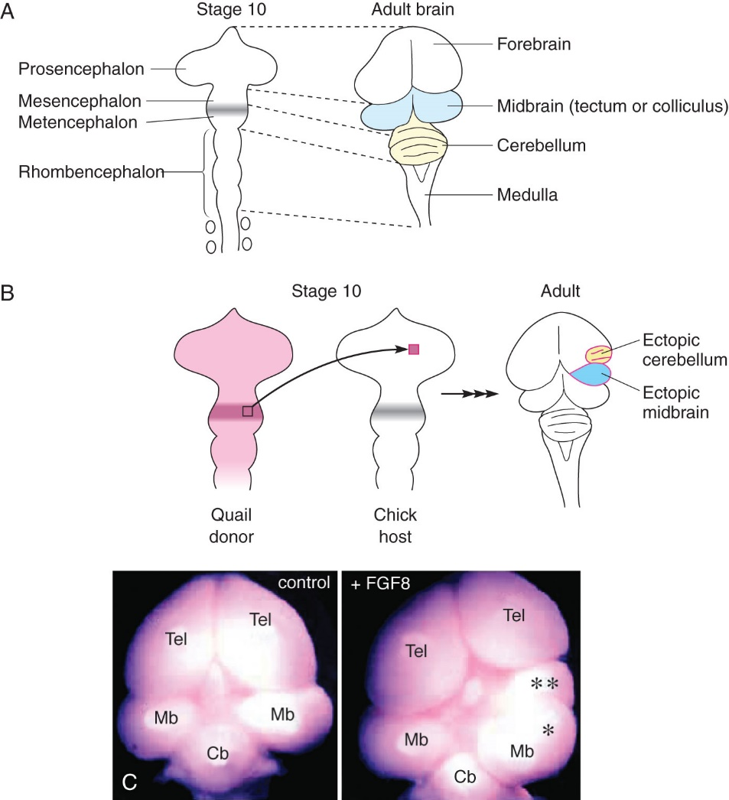
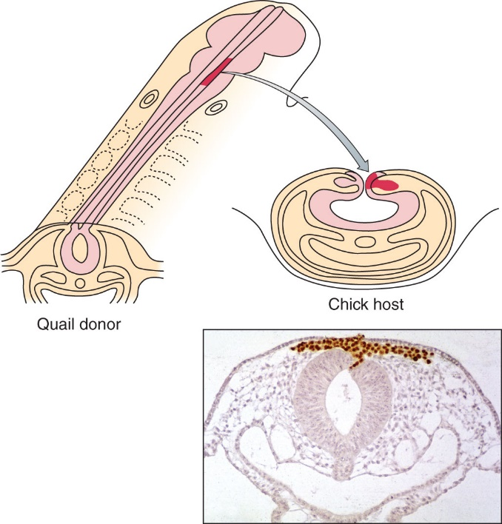
FGF8 patterns hindbrain

Slide 12
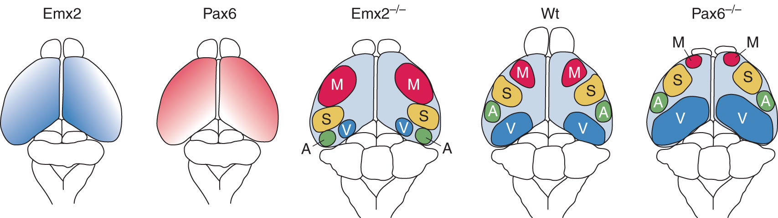
Patterning the Cerebral Cortex: Emx2 & Pax6

Slide 13
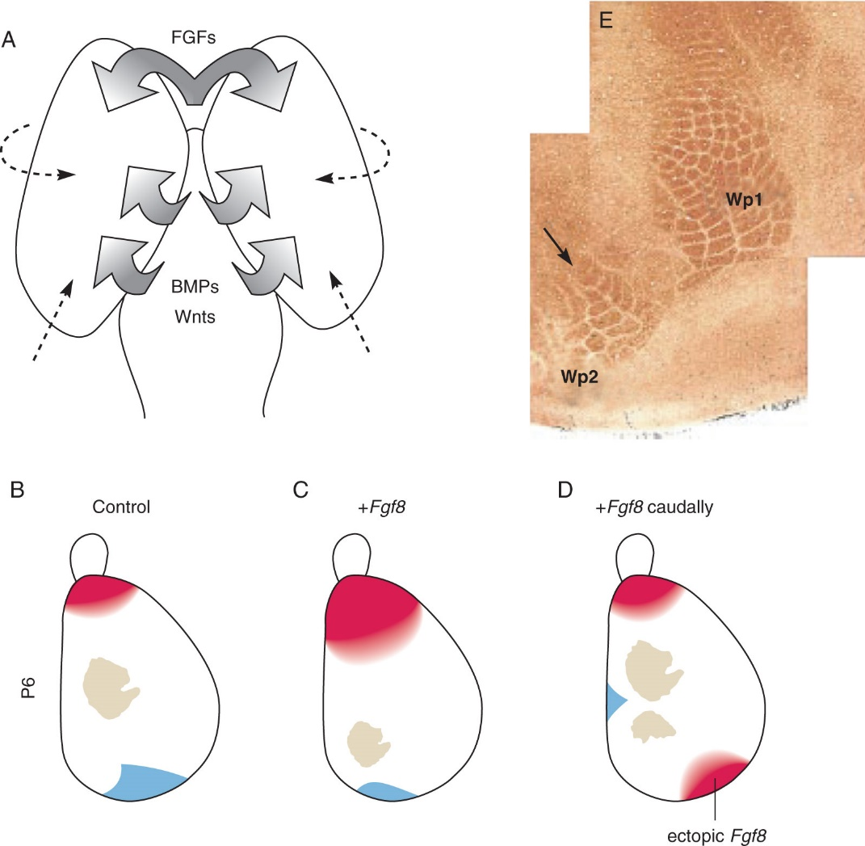
Cerebral Cortex: FGFs and BMPs

Slide 14
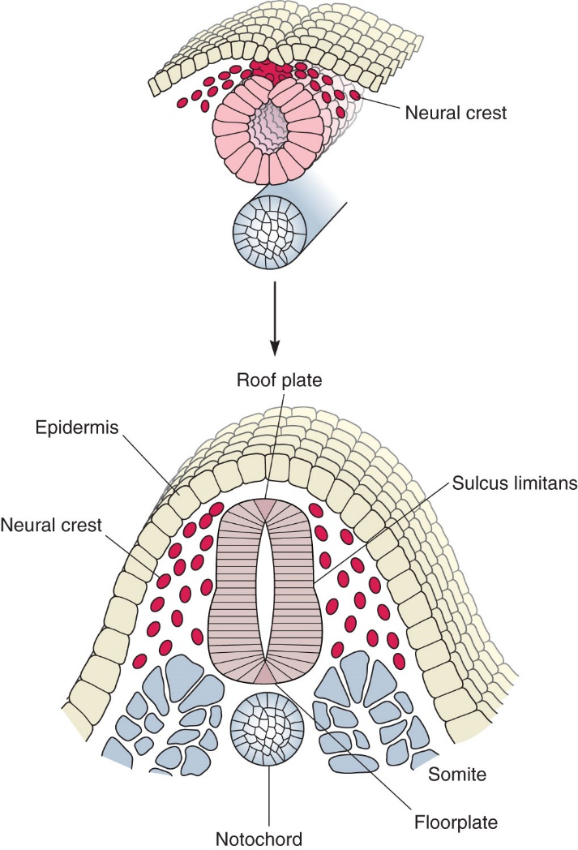
Dorsal-Ventral Polarity

Slide 15
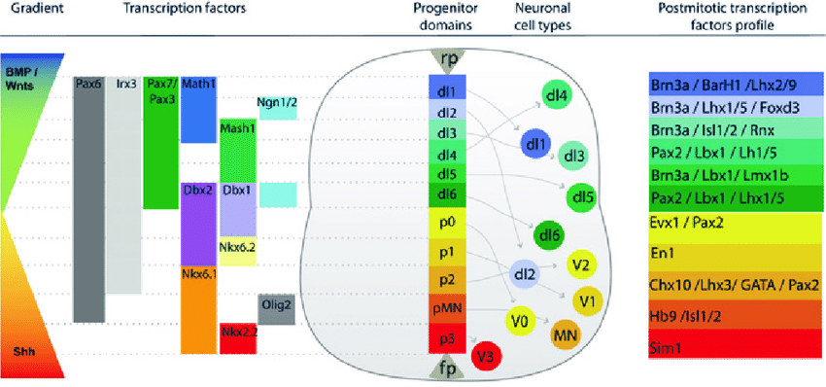
Early Morphogens Set up Terminal Fates

Slide 16
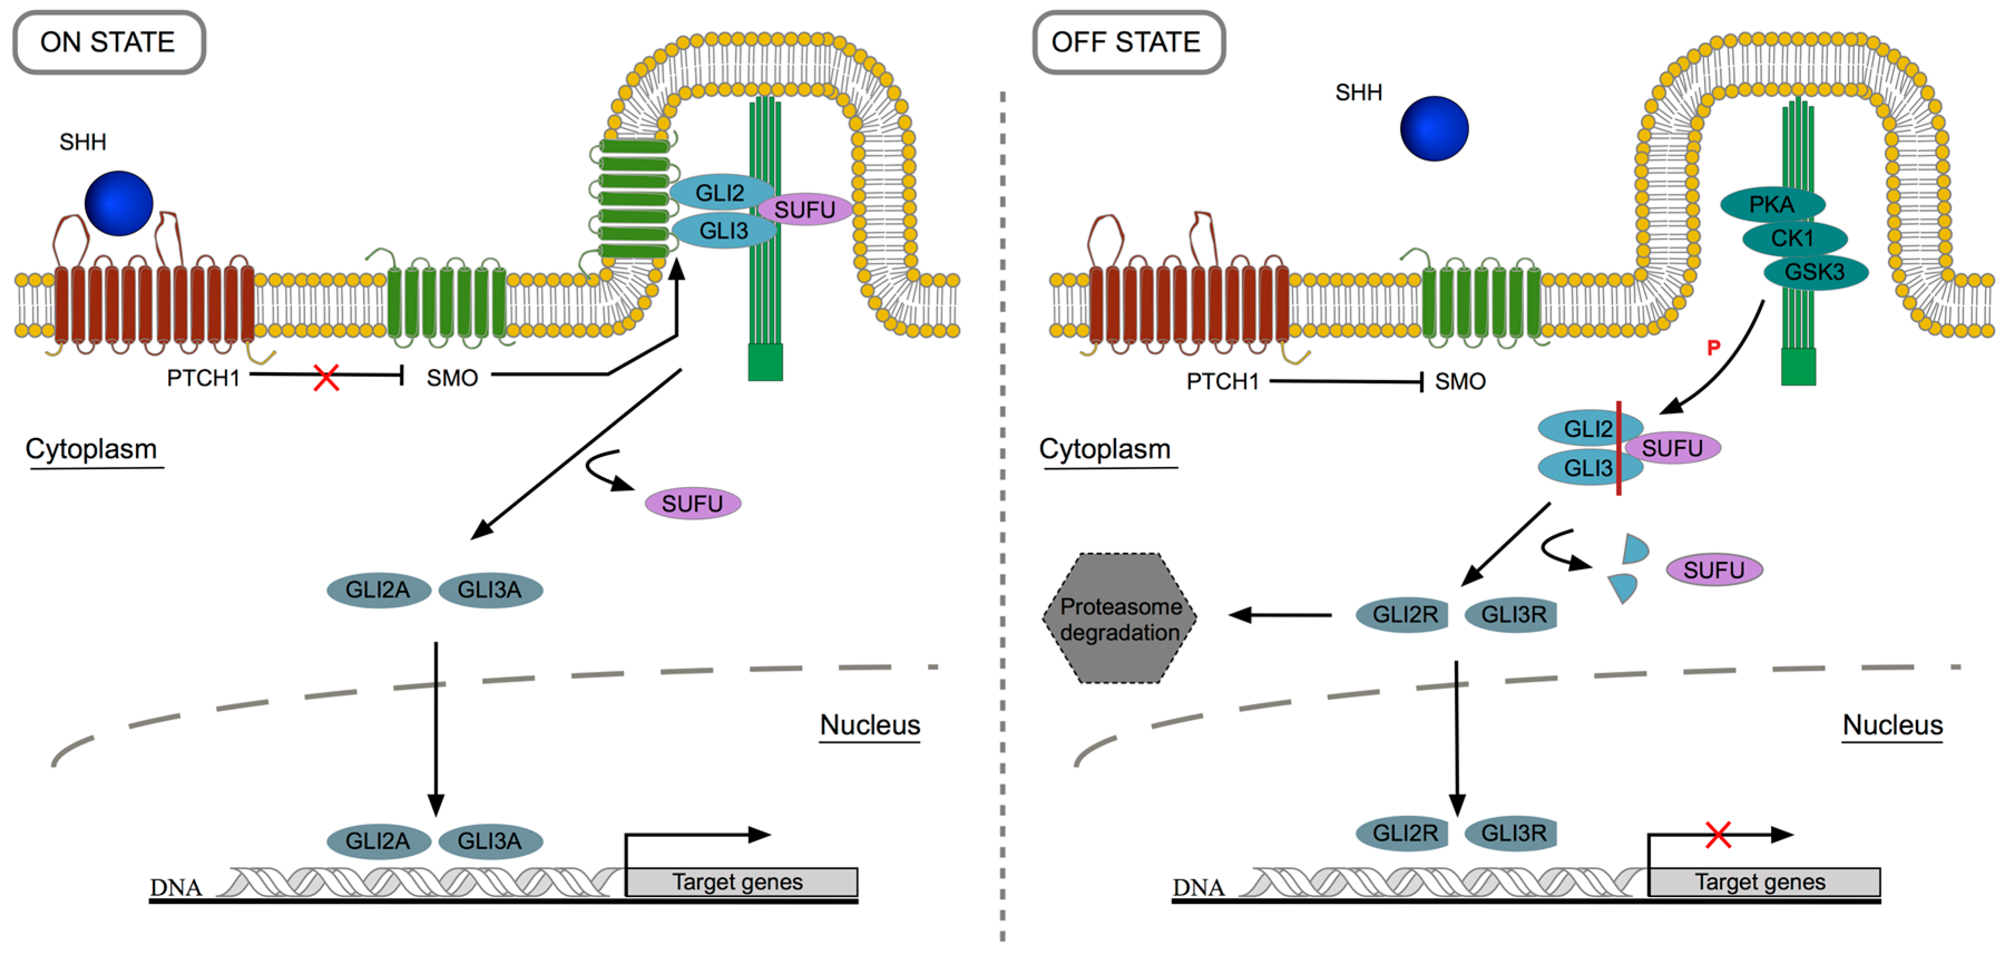
SHH Pathway

Slide 17
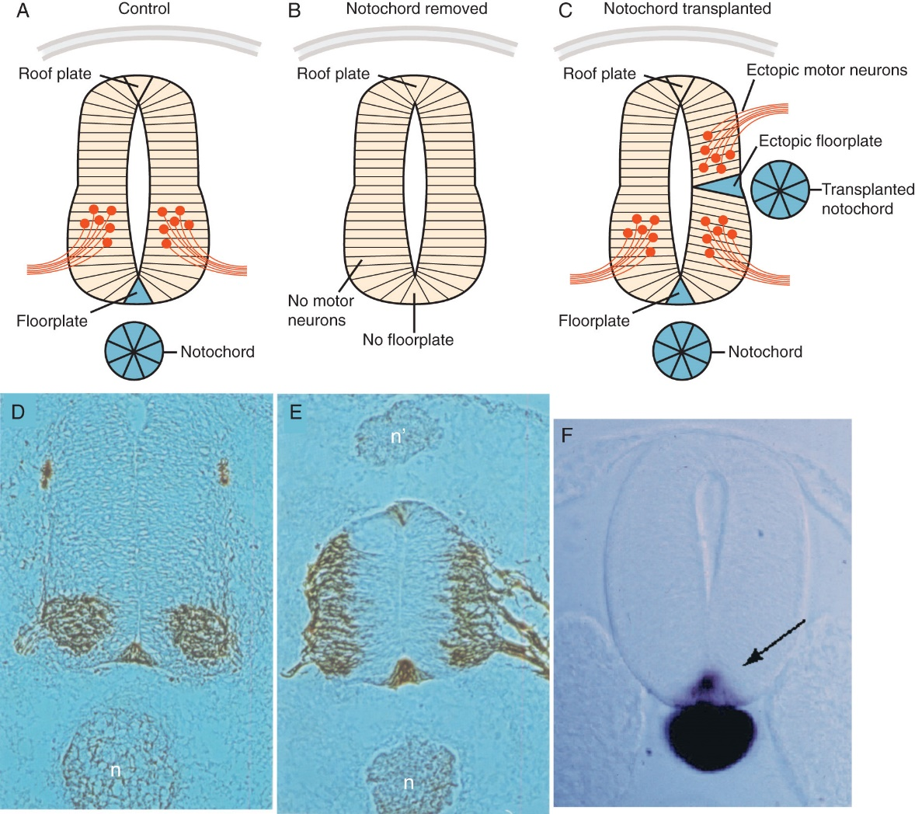
Hedgehog Signaling Ventralizes NSCs

Slide 18
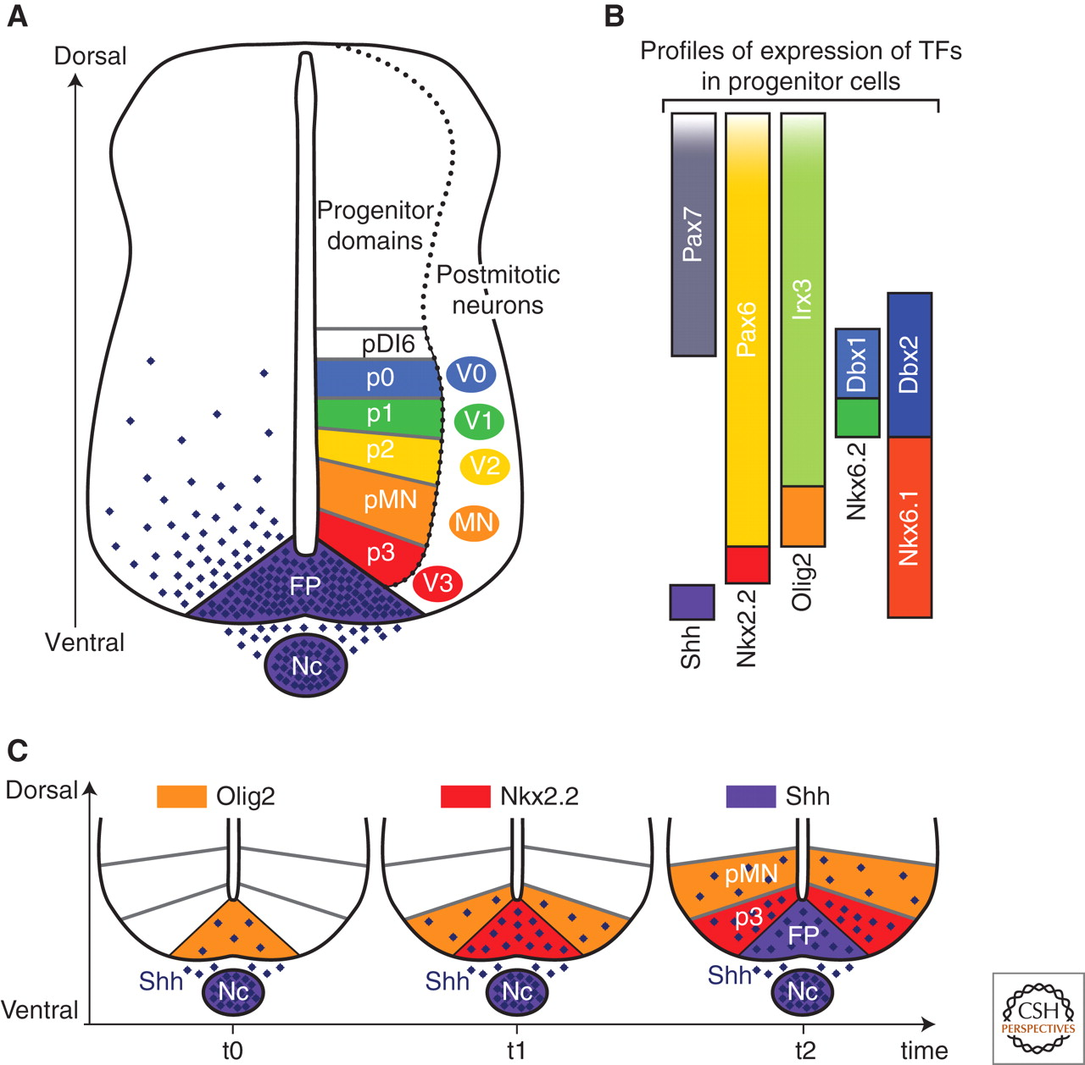
SHH sets up transcription factor expression

Slide 19
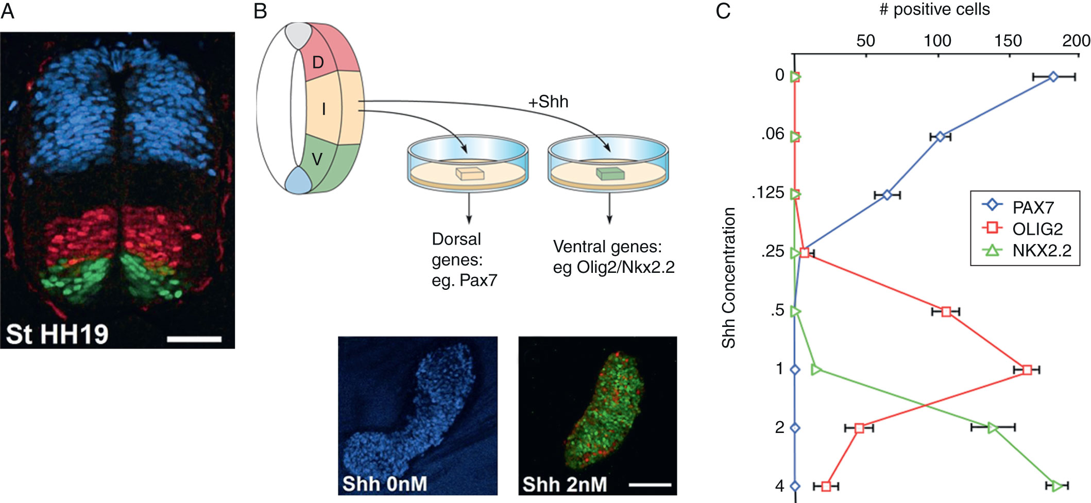
Shh Gradient Sets Up TF Network

Slide 20
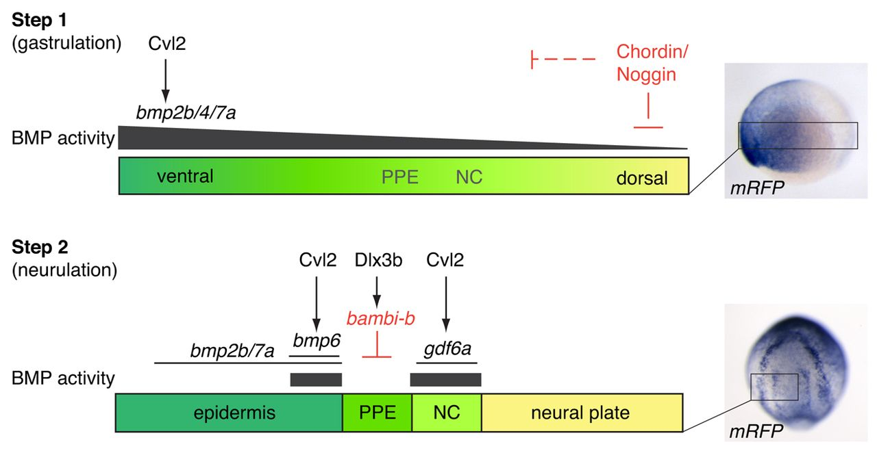
BMPs and Dorsal Fates

Slide 21
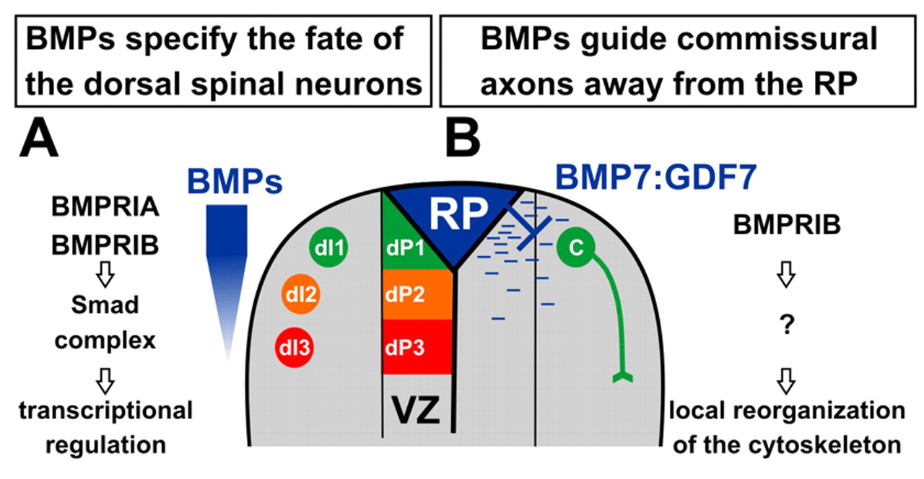
BMPs during NT formation and later

Slide 22
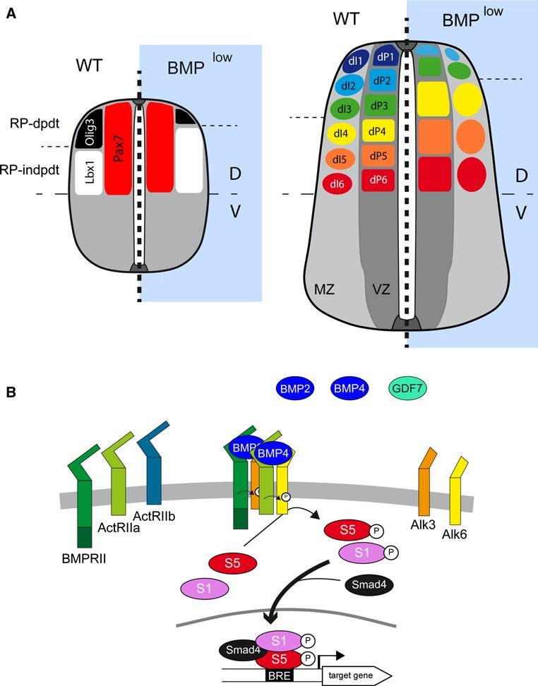
BMPs expand dorsal lineages

Slide 23
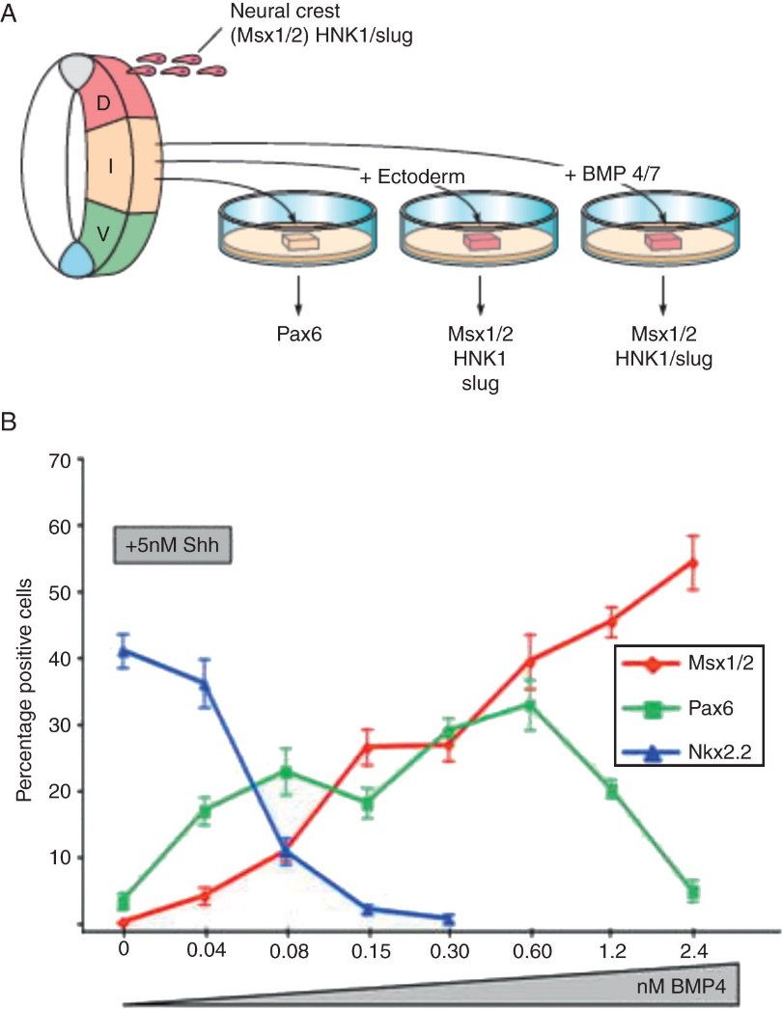
BMPs Induce a Dorsal Fate

Slide 24
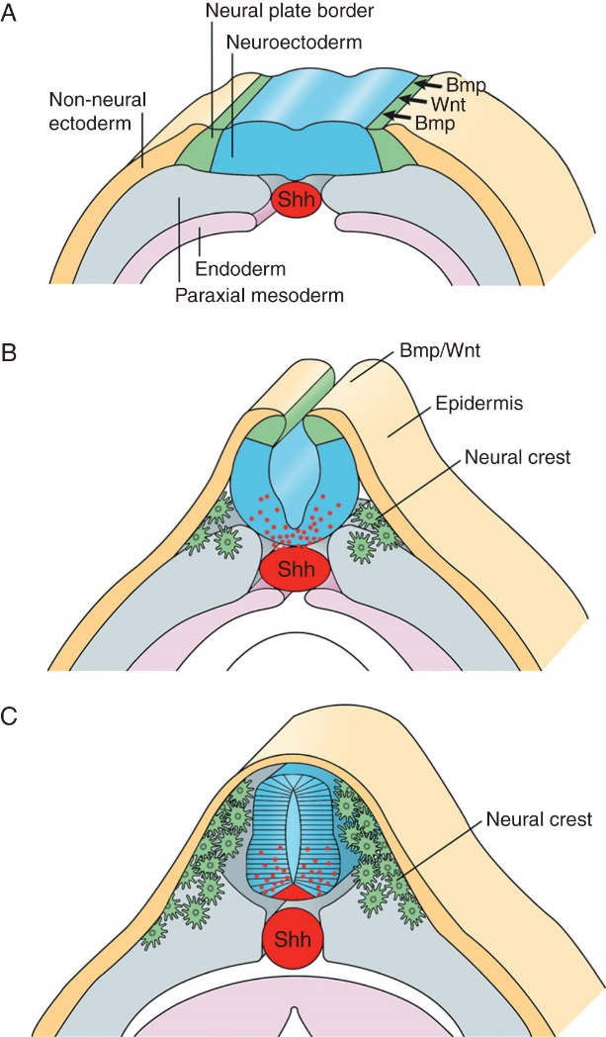
A Current Model of D-V Patterning

